Slide 1

PYTHON
LOOPS

Slide 2

OBJECTIVES
Loops in Python
While loop
For loop

Slide 3
LOOPS
Loops are instruction which are performed multiple no of times to get a specific output.
Two loops in Python:
FOR loop
While loop

Slide 4

While Loop
The code in a while clause will be executed continuously till the condition in “while-statement” remains True.
SYNTAX :

Slide 5

For Loop
The code within a for clause get executed as many times as specified by the user.
SYNTAX :

Slide 6
While vs for loop
Cheat-sheet
Use a for loop to iterate over an array.
Use a for loop when you know the loop should execute n times.
Use a while loop for reading a file into a variable.
Use a while loop when asking for user input.
Use a while loop when the increment value is nonstandard.[1]

Slide 7
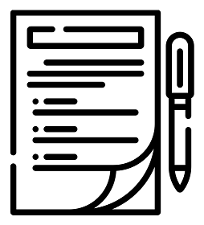
SUMMARY
Loops are instruction which are performed multiple no of times to get a specific output.
There are two types of loops:
while loop
for loop
Notes:
https://www.w3schools.com/python/python_ref_string.asp

Slide 8
References
[1] How to Pick Between a While and For Loop, Jonathan Hsu,
https://betterprogramming.pub/how-to-pick-between-a-while-and-for-loop-14ef217c3776

